Slide 1
CS 31006: Computer Networks – History and Protocol Stack

Slide 2
Circuit Switching – the Beginning
The concept of how telephone switching works – creates a dedicated communication links between two communication nodes (telephones)
In January 1878, the first telephone switch went into operation in New Haven Connecticut.

Slide 3
Circuit Switching
Source: http://comp380group4project1.web.unc.edu/technical-discussion/circuit-switching/

Slide 4
Problem with Circuit Switching for Data Communication
Data traffic is bursty – uses an on-off pattern for data communication.

Slide 5
Packet Switching
Decide data boundary from the communication of one user – data packets
Packet Multiplexing

Slide 6
The First Packet Switching Network
Robert Taylor was promoted to the head of the information processing office at Defense Advanced Research Projects Agency (DARPA) in June 1966. He intended to realize Licklider's ideas of an interconnected networking system. Bringing in Larry Roberts from MIT, he initiated a project to build such a network. The first ARPANET link was established between the University of California, Los Angeles (UCLA) and the Stanford Research Institute at 22:30 hours on October 29, 1969.
Kleinrock said in an interview: "We typed the L and we asked on the phone,
"Do you see the L?"
"Yes, we see the L," came the response.
We typed the O, and we asked, "Do you see the O."
"Yes, we see the O."
Then we typed the G, and the system crashed ...
Yet a revolution had begun"
By December 5, 1969, a 4-node network was connected by adding the University of Utah and the University of California, Santa Barbara.
Source: Wikipedia

Slide 7
ARPANET – The First Packet Switching Network

Slide 8
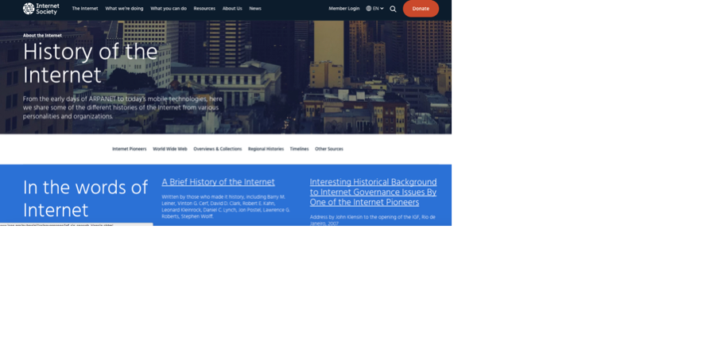
History of Computer Networks
https://www.youtube.com/watch?v=9hIQjrMHTv4
https://www.internetsociety.org/internet/history-internet

Slide 9
TCP/IP Protocol Stack
Application
Application
Transport
Transport
Network
Network
Network
Data Link
Data Link
Data Link
Data Link
Data Link
Physical
Physical
Physical
Physical
Physical

Slide 10
Transport Layer Services
Connection oriented communication
Create a logical connection between your machine and Google server
Process to process Connection
Identify processes using port number

Slide 11
Transport Layer Services
Connection oriented communication
Create a logical connection between your machine and Google server
Ordered delivery of data packets
Reliability
Flow control
Congestion avoidance

Slide 12
Network (Internet) Layer Services
Connectionless communication - construct messages (datagrams) from packets and route them to the next hop
Why do transport layer packets need to be converted to datagrams at every hop?
Host addressing - use IP addresses to uniquely identify a host in the network
Datagram routing - decide the path to route every datagram from the network graph

Slide 13
Data Link Layer Services
Encapsulation of network layer data packets into frames
Frame synchronization
Error control
Flow control
Why do we need flow control at the link layer?
Channel access / medium access, Physical addressing

Slide 14
Data Link Layer
Logical Link Control (LLC)
Error control and flow control
Medium Access Control (MAC)
Channel access and physical layer
addressing

Slide 15
Addressing a Host in the Network
Every host has two addresses –
Logical address (IP address) – used to find out the path towards a host
Physical address (MAC address) - uniquely identify a host in the Internet
Logical address – Dr. Sandip Chakraborty, Room-311, Department of Computer Science and Engineering, IIT Kharagpur, Kharagpur - 721302, West Bengal, India
Physical address – My Aadhar number (XXXX XXXX XXXX)

Slide 16
Addressing a Host in the Network
Every host has two addresses –
Logical address (IP address) – used to find out the path towards a host
Physical address (MAC address) - uniquely identify a host in the Internet
Logical address (32 bit IP address) – 172.16.32.64
Physical address (64 bit MAC address) – 00:00:00:14:22:01:2C:4D

Slide 17
Protocol Stack Implementation in a Host
Application
Software, Kernel
Transport
Network
Data Link
Firmware, Device Driver
Physical
Hardware

Slide 18
How Application Data Passes Through Different Layers
Application
HTTP Header
HTTP Data
Transport
TCP Header
HTTP Header
HTTP Data
Network
IP Header
TCP Header
HTTP Header
HTTP Data
Data Link
MAC Header
IP Header
TCP Header
HTTP Header
HTTP Data
Physical
PHY Header
MAC Header
IP Header
TCP Header
HTTP Header
HTTP Data
PHY Trailer

Slide 19
How do you access a page at www.google.com?
Application Layer: Use DNS to get the IP address of the Google server - DNS returns 74.125.224.72
Application Layer: Construct an HTTP GET Request – GET 74.125.224.72/index.html HTTP/1.1 Construct an HTTP packet and forward it to the transport layer

Slide 20
How do you access a page at www.google.com?
Transport Layer: Construct the transport layer packet (TCP packet)
Source port: 3324 (port address corresponding to your browser tab)
Destination port: 80 (port for a HTTP server)

Slide 21
How do you access a page at www.google.com?
Network Layer: Construct the network layer packet (IP packet)
Source IP: 172.16.22.121 (IP of your machine)
Destination IP: Next hop IP for 74.125.224.72 (use the routing procedure to get this IP)

Slide 22
How do you access a page at www.google.com?
Network Layer: Use the routing procedure to find out the next hop IP to reach the Google server at 74.125.224.72. Let this IP be 172.16.28.192
172.16.22.121
172.16.28.192
74.125.224.72

Slide 23
How do you access a page at www.google.com?
Data Link Layer: Construct the data link layer frame from the IP datagram.
How do we get destination MAC address? We need the MAC address corresponding to 172.16.28.192
Gateway
172.16.22.121
172.16.28.192
Local Area Network (LAN)

Slide 24
How do you access a page at www.google.com?
Data Link Layer: Use ARP protocol to get the MAC address corresponding to 172.16.28.192
Gateway
172.16.22.121
172.16.28.192
Local Area Network (LAN)

Slide 25
In Summary
Application
HTTP Header
HTTP Data
Transport
TCP Header
HTTP Header
HTTP Data
Network
IP Header
TCP Header
HTTP Header
HTTP Data
Data Link
MAC Header
IP Header
TCP Header
HTTP Header
HTTP Data
Physical
PHY Header
MAC Header
IP Header
TCP Header
HTTP Header
HTTP Data
PHY Trailer

Slide 26
Internet Architecture
Autonomous Systems (AS) – A set of LANs for an administrative domain, identified by a unique AS number, and the routing policies are controlled by a single administrator.

Slide 27
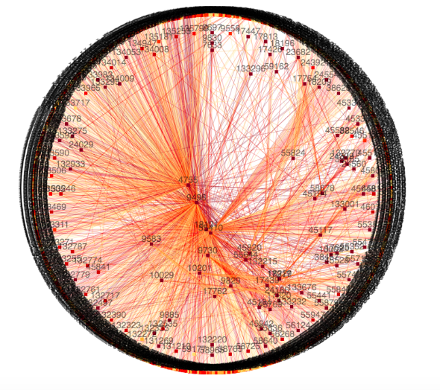
Autonomous System Graph for India
Source: https://labs.apnic.net/vizas/#IN

Slide 28
Internet Architecture

Slide 29
Peering between ISPs

Slide 30
Communication between Two Nodes over ISPs

